Slide 1


INTRODUCTION TO REACT JS

Slide 2
What is React JS?
React is a JavaScript library for building user interfaces.
React is used to build single-page applications.
React allows us to create reusable UI components.
React, sometimes referred to as a frontend JavaScript framework, is a JavaScript library created by Facebook.
React is a tool for building UI components.

Slide 3
COMPONENTS
React Components
Components are independent and reusable bits of code. They serve the same purpose as JavaScript functions, but work in isolation and return HTML.
Components come in two types, Class components and Function components ,we will concentrate on Function components.

Slide 4
JSX
JSX stands for JavaScript XML.
JSX allows us to write HTML in React.
JSX makes it easier to write and add HTML in React.
JSX converts HTML tags into react elements.
You are not required to use JSX, but JSX makes it easier to write React applications.

Slide 5
PROPS VS STATE
Props are used to pass data from a parent component to a child component, while state is used to manage data within a component.
Props are immutable and cannot be changed within a component, while state is mutable and can be updated using the setState function.

Slide 6
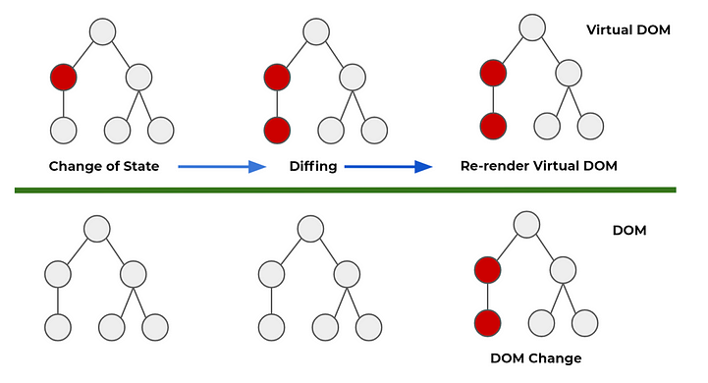
virtual dom vs real dom
DOM is the actual document object model that exists in the browser, while virtual DOM is a lightweight DOM tree constructed in memory.
Directly manipulating the DOM may be slow, while using virtual DOM can improve performance because virtual DOM updates only the changed parts.

Slide 7
useState()
The useState() hook works by handling and managing state in your applications.
The useState() hook takes the first (initial) value of the state variable as its argument. The second value then sets your state
const [state, setState] = useState(initial values goes here)

Slide 8
useState code
import React, { useState } from 'react';
const Newcounter = () => {
const [count, setCount] = useState(0)
const incrementCount = () => {
setCount(count + 1)
}
return (
<div> <button type="button" onClick={incrementCount}>You clicked {count} times</button>
</div>
)
}
export default Newcounter;

Slide 9
useEffect()
The useEffect() Hook allows you to perform side effects in your components. Some examples of side effects are: fetching data, directly updating the DOM, and timers. useEffect accepts two arguments. The second argument is optional.

Slide 10
useEffect code
import React, { useState, useEffect } from "react";
const Effect = () => {
const [count, setCount] = useState(0);
useEffect(() => {
console.log("rendered");
},[]);
return (
<>
<button onClick={() => setCount(count + 1)}>Click</button>
<p>{count}</p>
</>
);
};
export default Effect;

Slide 11
REACT HOOKS
useState()
useEffect()
useRef()
useMemo()
useCallback()
useContext()
useReducer()

